Slide 1
Unsupervised Learning
Dr. Nwe Nwe Htay Win
nwenwehtaywin@parami.edu.mm
Faculty of Mathematics and Science

Slide 2
Contents
Hierarchical Agglomerative Clustering (HAC)
DBScan

Slide 3
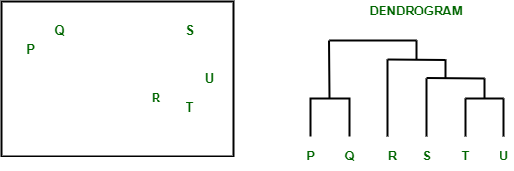
Hierarchical Clustering
Hierarchical clustering is a machine learning technique used to organize data into a nested cluster structure, resembling a tree.
It builds a hierarchy of clusters by either agglomerating (merging small clusters into larger ones) or divisively splitting larger clusters into smaller ones based on their similarity.

Slide 4
Types of Hierarchical Clustering Agglomerative vs. Divisive Clustering
Hierarchical Agglomerative Clustering (HAC) – Bottom-Up Approach
Hierarchical clustering is a method that groups data into a structured hierarchy. Unlike flat clustering methods (like k-means), hierarchical clustering does not require predefining the number of clusters.
Divisive Clustering (Top-Down Hierarchical Clustering)
Divisive clustering is a top-down hierarchical clustering approach that starts with all data points in a single cluster and then recursively splits them into smaller subclusters until each data point is its own cluster.

Slide 5
HAC algorithms
The steps for agglomerative clustering are:
Compute the proximity matrix using a distance metric.
Use a linkage function to group objects into a hierarchical cluster tree based on the computed distance matrix from the above step.
Data points with close proximity are merged together to form a cluster.
Repeat steps 2 and 3 until a single cluster remains.

Slide 6

HAC: Calculation Steps
Step 1: We calculate the Euclidean distance between all pairs of points using the formula:
Step 3: Update the Distance Matrix (Using Single Linkage)
The distance between the new cluster (AB) and the remaining points is computed using the minimum distance:
 | A | B | C | D
A | 0 | 3.16 | 5.10 | 7.81
B | 3.16 | 0 | 4.47 | 3.61
C | 5.10 | 4.47 | 0 | 5.10
D | 7.81 | 3.61 | 5.10 | 0
 | AB | C | D
A | 0 | 4.47 | 3.61
C | 4.47 | 0 | 5.10
D | 3.61 | 5.10 | 0
Step 2: Find the Closest Points and Merge
The smallest distance is 3.16 (between A and B).
Merge A and B into a single cluster (AB).
Step 4: Merge the Next Closest Cluster
The next smallest distance is 3.61 (between AB and D).
Merge (AB) and D into a new cluster (ABD).
Step 5: Repeat the steps until all are merged into a single final cluster (ABCD)

Slide 7
Final Dendrogram
The hierarchical clustering process can be visualized as:
A dendrogram is a tree-like diagram that visualizes the process of hierarchical clustering, showing how data points or clusters merge (or split) step-by-step.
The Ward method (also called Ward’s minimum variance method) is a specific linkage criterion used in Agglomerative Hierarchical Clustering to determine which clusters to merge at each step.
┌─────(ABCD)
│
├──(ABD)──────C
│
├──(AB)──────D
│
A──────B

Slide 8
Ward Method
Goal: Minimize the increase in within-cluster variance when merging two clusters.
Dendrogram with Ward Method
Structure:
Leaves: Individual data points (bottom of the tree).
Branches: Merges of clusters as you move up.
Height: Represents the "distance" (increase in variance) when two clusters are merged using the Ward method.
linkage(X_scaled, method='ward') computes the merges using Ward’s method.

Slide 9
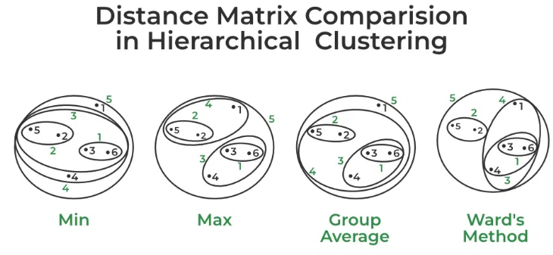
Computing Distance Matrix
While merging two clusters we check the distance between two every pair of clusters and merge the pair with the least distance/most similarity. But the question is how is that distance determined. There are different ways of defining Inter Cluster distance/similarity. Some of them are:
Min Distance: Find the minimum distance between any two points of the cluster.
Max Distance: Find the maximum distance between any two points of the cluster.
Group Average: Find the average distance between every two points of the clusters.
Ward’s Method: The similarity of two clusters is based on the increase in squared error when two clusters are merged.

Slide 10
How do I choose the right method for hierarchical clustering?
The choice of method depends on the structure of your data. For example:
Min Distance works well for elongated clusters.
Max Distance creates compact, well-separated clusters.
Group Average offers a balanced approach.
Ward’s Method tries to minimize the increase in squared error and maintains compact clusters.

Slide 11
Density based Clustering - DBSCAN
DBSCAN is a density-based clustering algorithm that groups data points that are closely packed together and marks outliers as noise based on their density in the feature space. It identifies clusters as dense regions in the data space, separated by areas of lower density.
Unlike K-Means or hierarchical clustering, which assume clusters are compact and spherical, DBSCAN excels in handling real-world data irregularities such as:
Arbitrary-Shaped Clusters: Clusters can take any shape, not just circular or convex.
Noise and Outliers: It effectively identifies and handles noise points without assigning them to any cluster.

Slide 12
DBSCAN
Density-based clustering algorithm.
Groups points in dense regions, identifies noise.
No need to specify number of clusters (unlike K-means).
The DBSCAN algorithm relies on two main parameters to identify clusters in your data:
eps (ε): This parameter defines the radius of a neighborhood around a data point. Points within this distance are considered neighbors of the central point.
minPts: This parameter represents the minimum number of points required within the ε-neighborhood of a point to classify it as a core point. A core point is considered to be dense enough to be part of a cluster.
In higher dimensions, the circle becomes a hypersphere, epsilon becomes its radius, and minPoints is the minimum number of data points required inside it.

Slide 13
How DBSCAN Works?
DBSCAN uses two key parameters:
eps (epsilon): The maximum distance between two points for them to be considered neighbors.
minPts: The minimum number of points required to form a dense region (cluster).
Steps:
Start with a random point and find all points within its eps radius.
If the point has at least minPts neighbors, it’s a core point, and a new cluster is formed.
Expand the cluster by adding all reachable points within the eps radius of the core point.
Repeat for all points in the cluster.
If a point doesn’t have enough neighbors, it’s marked as noise.
Continue until all points are processed.

Slide 14
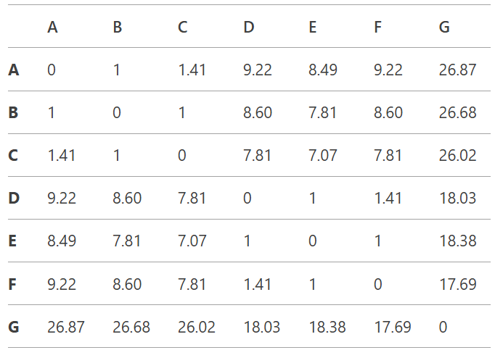
Calculation of DBSCAN
Distance Table (Using Euclidean Distance)
Point | X | Y
A | 1 | 1
B | 1 | 2
C | 2 | 2
D | 8 | 7
E | 7 | 7
F | 7 | 8
G | 20 | 20
eps = 2
minPts = 2

Slide 15
Calculation of DBSCAN, Cont’d
For each point, find all points within eps = 2.
Neighbors of Each Point
A: B (distance 1), C (distance 1.41) → Neighbors: B, C
B: A (distance 1), C (distance 1) → Neighbors: A, C
C: A (distance 1.41), B (distance 1) → Neighbors: A, B
D: E (distance 1), F (distance 1.41) → Neighbors: E, F
E: D (distance 1), F (distance 1) → Neighbors: D, F
F: D (distance 1.41), E (distance 1) → Neighbors: D, E
G: No neighbors within eps = 2 → Noise

Slide 16
Calculation of DBSCAN, Cont’d
Cluster 1:
Start with point A.
A has 2 neighbors (B, C), which meets minPts = 2. So, A is a core point.
Add A to Cluster 1.
Expand the cluster by adding all reachable points within eps = 2 of A:
B and C are added to Cluster 1.
Cluster 1: {A, B, C}.
Cluster 2:
Start with point D.
D has 2 neighbors (E, F), which meets minPts = 2. So, D is a core point.
Add D to Cluster 2.
Expand the cluster by adding all reachable points within eps = 2 of D:
E and F are added to Cluster 2.
Cluster 2: {D, E, F}.
Noise: G.
Final Result:
Cluster 1: {A, B, C}
Cluster 2: {D, E, F}
Noise: G

Slide 17
Key Takeaways
The choice of eps and minPts is critical. If minPts is too high, no clusters may form.
DBSCAN is great for identifying dense regions and separating noise.

Slide 18
Comparison of Clustering Algorithms
Feature | K-Means | Hierarchical Agglomerative | DBSCAN
Type | Distance-based | Hierarchical | Densty-based
Cluster Shape | Spherical | Any (depends on linkage) | Arbitrary
Noise Handling | Poor | Poor | Excellent
Number of Clusters | Requires K | Not required | Not required
Scalability | High | Low | Moderate
Parameter Tuning | K (number of clusters) | Linkage criterion | eps and minPts
Use Case | Well-separated, spherical data | Small datasets, hierarchies | Arbitrary shapes, nosiy data

Slide 19
References
https://www.analyticsvidhya.com/blog/2020/09/how-dbscan-clustering-works/

Slide 20
End

